Slide 1

Health Me 101
Group 2:
Kennedy Cyprain, Anil Gurung, Delano Powell, Quincy Pyles, Austin Scott, and Justin Stephenson

Slide 2
Agenda
Introduction
Goals
Target Audience
Project schedule
Tools
Current Product
Planned Features
Deployment Plan

Slide 3
Introduction
healthME101 is a website made for the purpose of helping high schoolers prepare for high school sports and helping them to stay in good health and shape, both in and out of their sports seasons. To achieve this goal our website uses quizzes to help the teens learn useful information and test their knowledge, a section where they can look for professional help in their area, and a section where they can post and view content on a social media feed so that they can stay engaged with each other.

Slide 4

Build a fun interactive learning experience for teens.
Focus on both desktop and mobile compatibility.
Goals

Slide 5
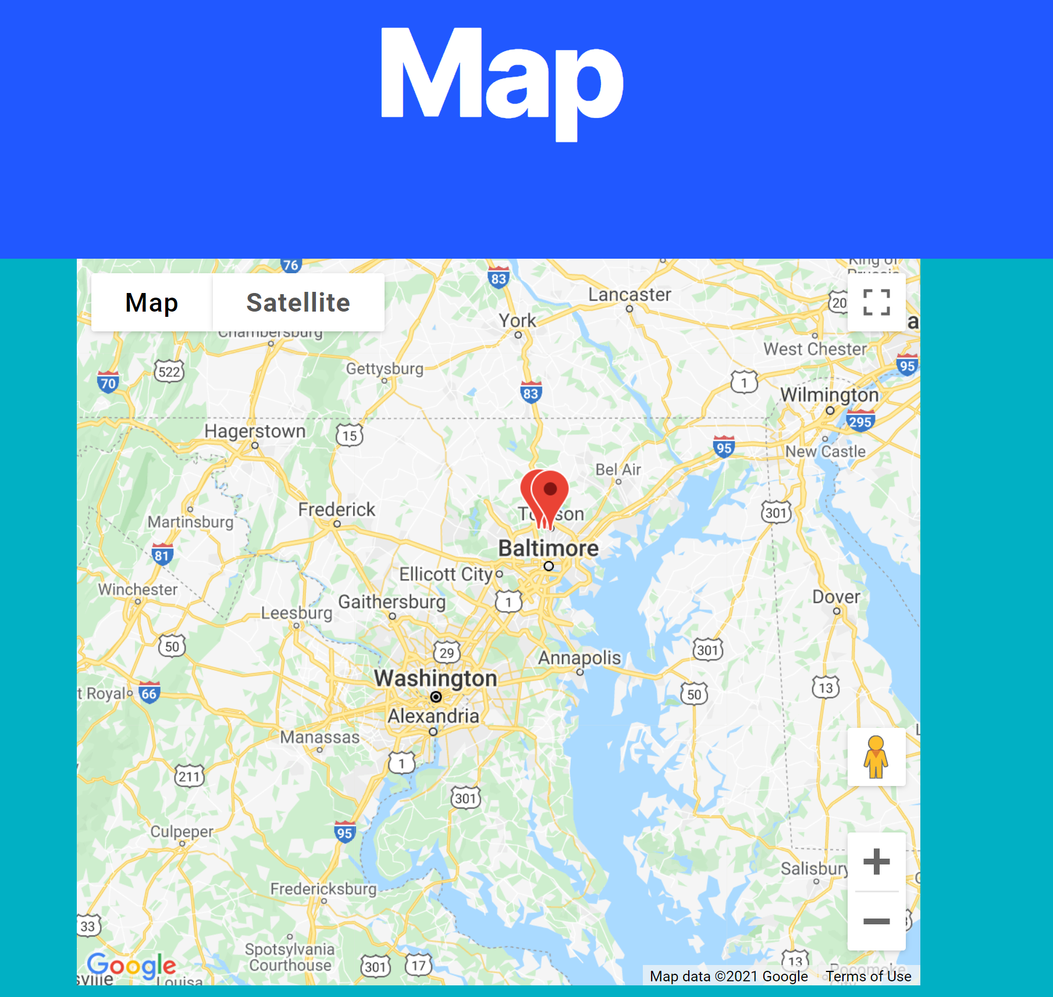
Map
Google maps api
Wp map plugin
Paid version
JavaScript implementation

Slide 6

Target Audience
The target audience for HealthMe101 is primarily Athletes, Coaches, and other Officials.

Slide 7
Project Schedule
2/25/2021 - Requirements
2/25/2021 - Use Cases and sequence diagrams
4/06/2021 - Begin development of website
4/08/2021 - Continued development
4/25/2021 - Website complete
5/18/2021 - Presentation

Slide 8
Tools
Plugins: BuddyForms, Ultimate Member, WooCommerce, WooCommerce Stripe Gateway, WPGoogleMaps, Typeform, BuddyForms UltimateMember, WebFlow Pages, UserSubmitted Post, Ultimate Member Online
Database : integrated WordPress MySQL database managed through phpMyAdmin
Domain Name: Namecheap
Hosting : Namecheap (WordPress Hosting)

Slide 9
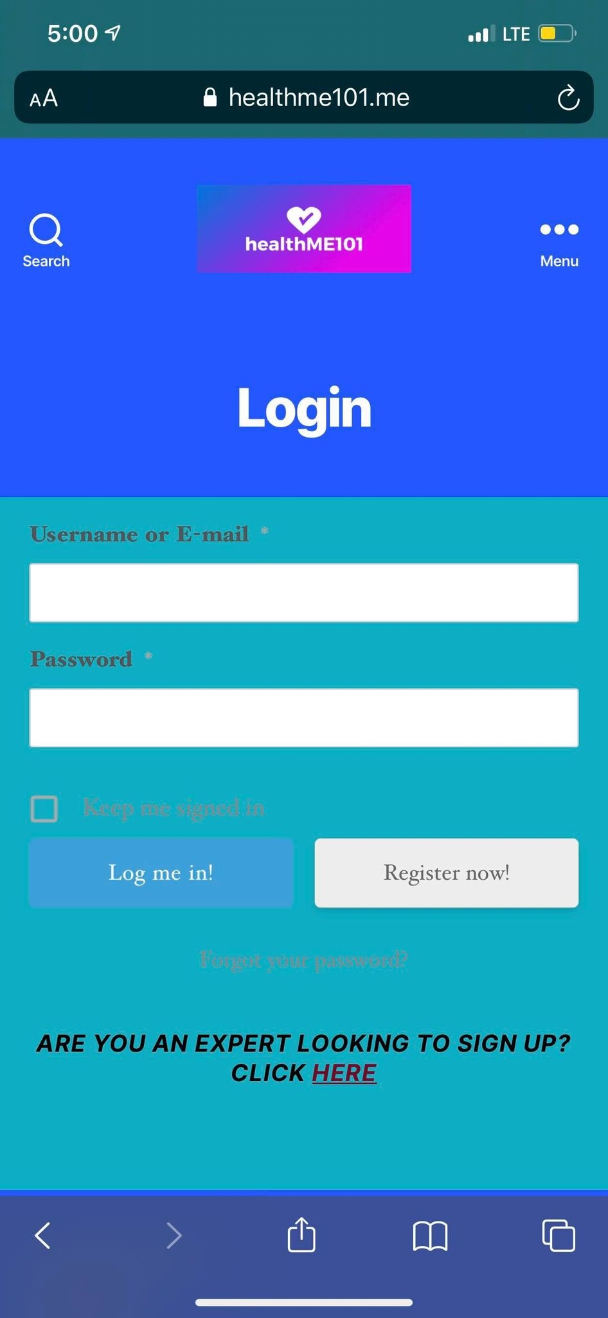
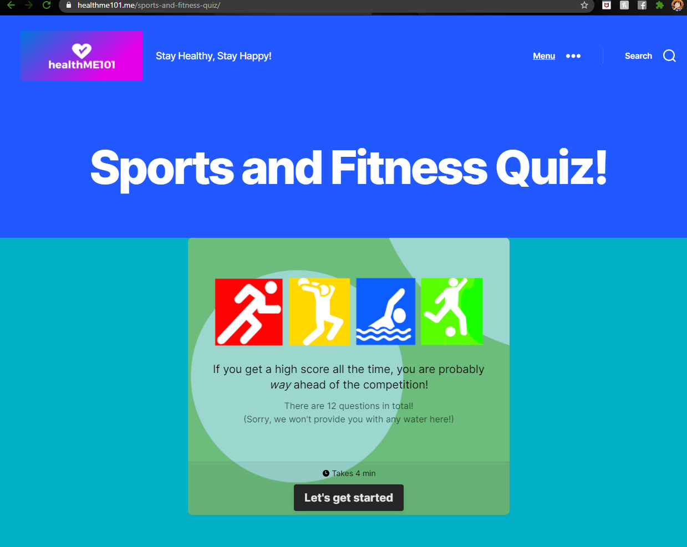
DESKTOP AND MOBILE VIEW

Slide 10
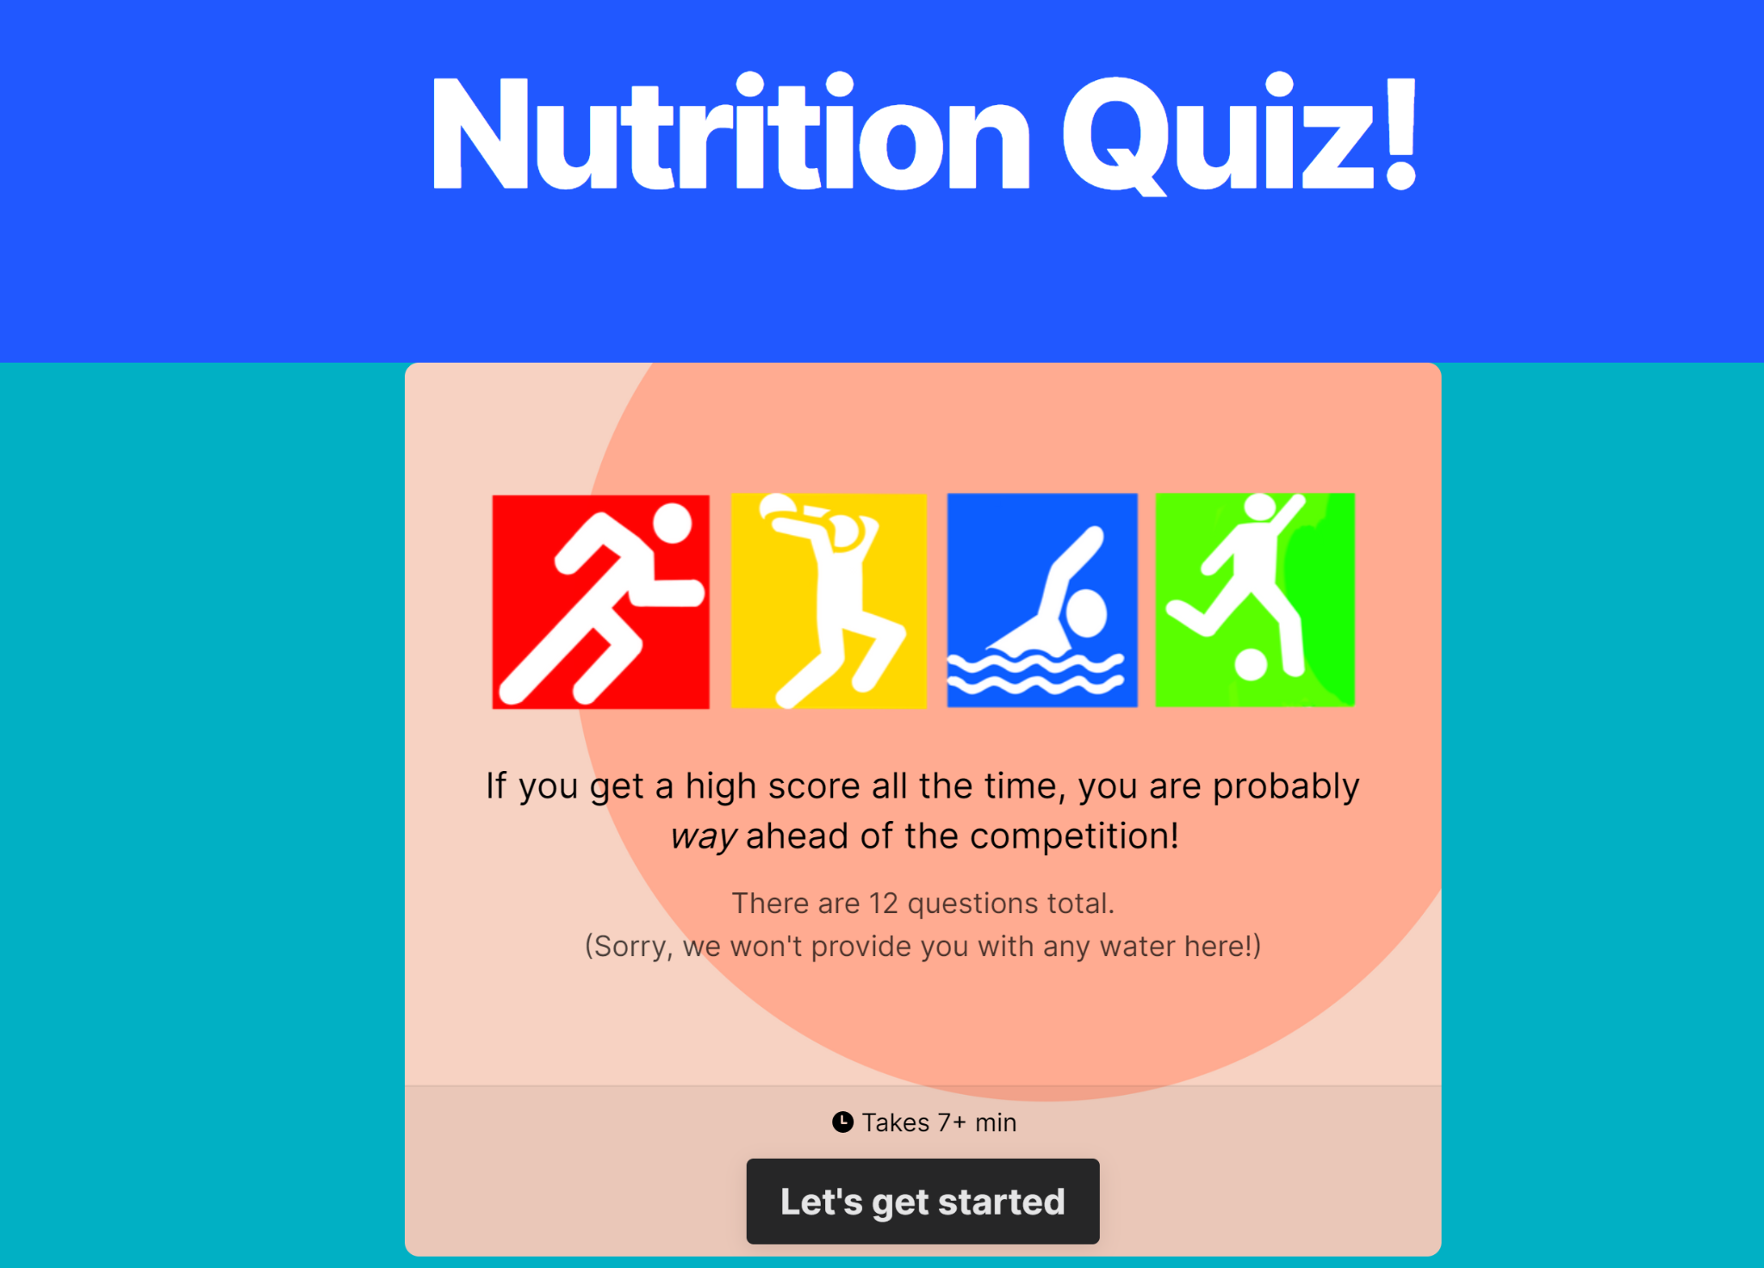
Website-HealthMe101

Slide 11
Current Product
Ability to register user Accounts.
Interactive quiz games teaches children and teens about healthy choices.
Ability to submit a post
View map
View and comment on other’s post through the feed page
Ability to add subscription to cart and checkout through stripe
Signup/request for professionals
Password reset for all users
View other member profiles
Online statuses for all members

Slide 12
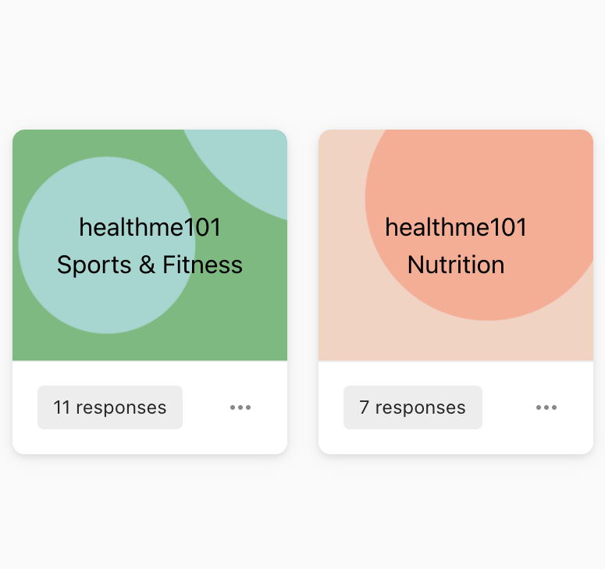
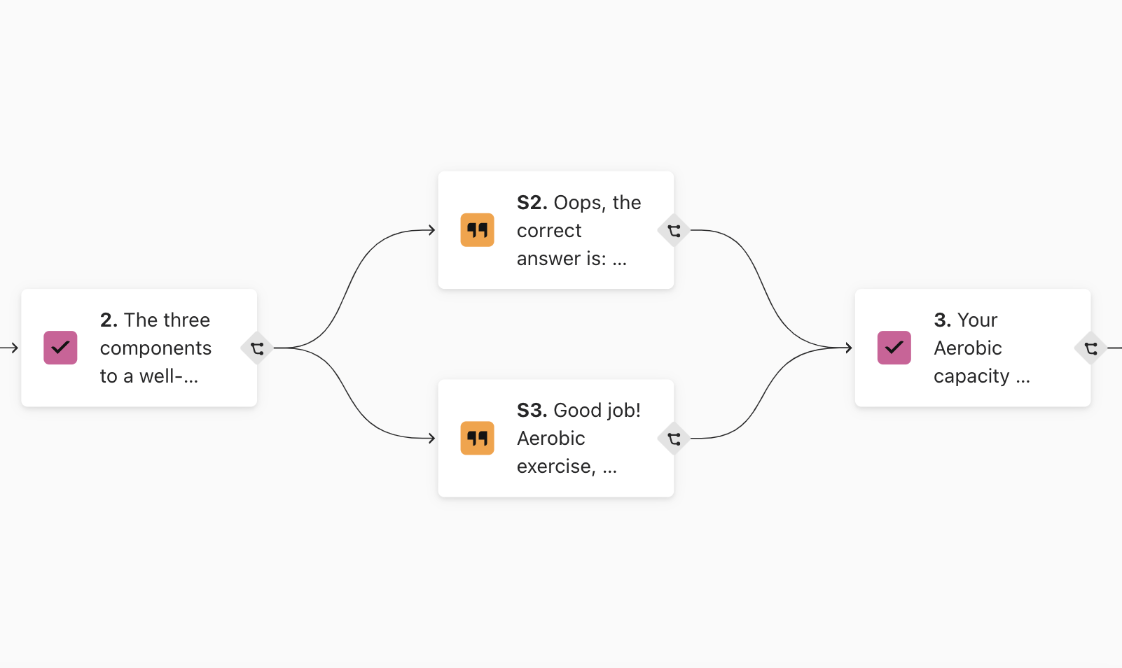
Typeform

Slide 13
Planned Features
Plans for the future of the website include:
Making recurring payments work with choices between monthly and yearly
Adding more quizzes with better information about the correct answer
Transition to an app
Streamline the signup process
Give the professionals separate pages

Slide 14
Deployment Plan
Nothing needs to be directly installed on a server besides wordpress as we have a full backup of files and all functionality is handled through WordPress or APIs
Site can be migrated to any server running wordpress by using a backup of our current files
The database can be moved to any MySQL database with a copy of our data files
Our SSL certificate should be transferable to another server if it is needed
For now storage use is well under 10gb but if more users become active and more data is saved that number could quickly increase
Website should be intuitive to use but if users are having problems using the website, customer support will be available to help them learn the website
With backups of the website being saved, to roll back we just restore the website from the last known working backup

